Slide 1



Gen AI Passenger Assistant - SAVVy

Slide 2
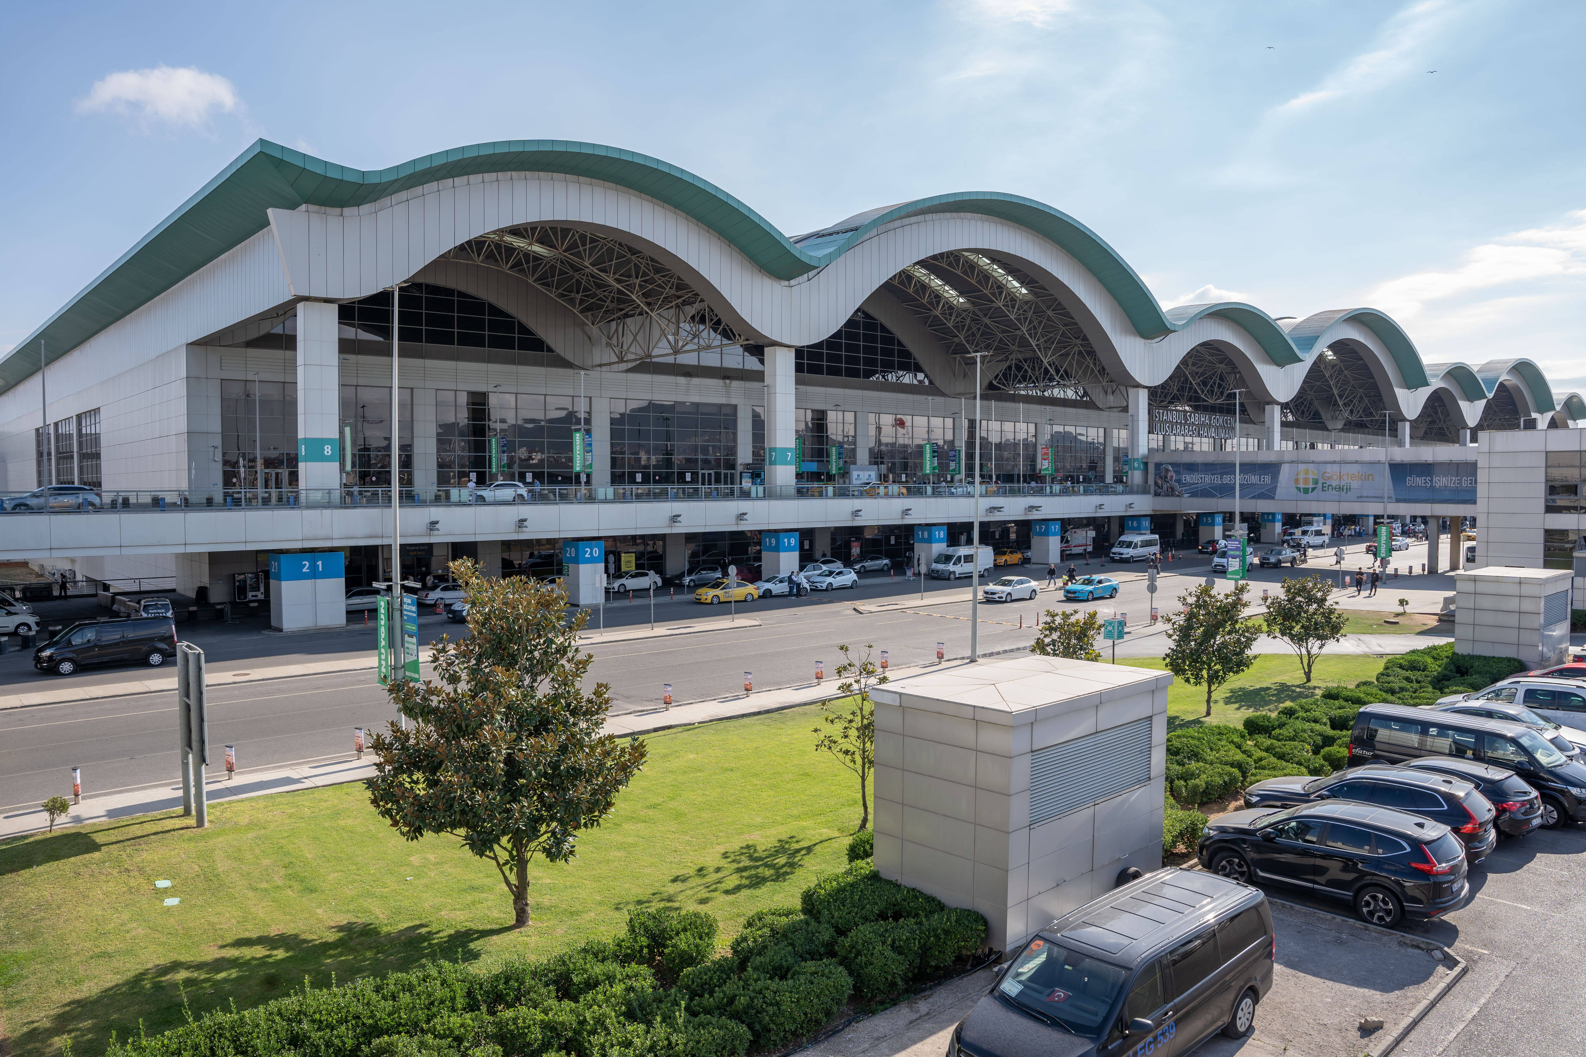

SAW Statistics
41,5 m
2024 PAX Number
Domestic
International
41.5
Total
M Passenger
No 2
37.1
The 2nd busiest airport of Turkiye
35.5
30.8
No 11
25.0
11th busiest airport in Europe
16.9
Operating 2 runways since ’23 Dec
2
9600 Baggage/Hour
BHS Bag process capacity

Slide 3


Main pain points of a passenger during the journey
How much is the parking payment?
How can I reach to the Airport?
How long is the passport queue?
Can I put my cream into my bag?
Can I get information about my flight?
How is the carpark availability?
Has boarding started?
Can you calculate my carpark fee?
Is check-in crowded?
How is the weather in London?

Slide 4

Meet with SAVVy!
SAVVy is an AI-based digital assistant that efficiently answers passenger inquiries and provides 24/7 support.
It enhances the customer experience by offering instant responses and personalized solutions through human-like conversations.
Passengers can receive quick responses through SAVVy without having to wait to connect with a customer representative.
Developed in collaboration with ISG, SAVVy utilizes Softtech Intelligence’s mAistro product and the GPT-4o model on the Azure platform.
The name SAVVy is derived from the IATA code "SAW" of Sabiha Gökçen Airport and also refers to the word "savvy" in English, meaning “comprehension" This name symbolizes the airport’s hospitality.

Slide 5
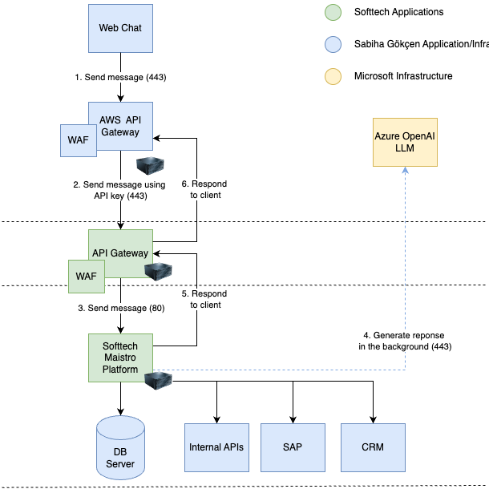
System
Overview
Flight Info API
Carpark Availability API
Weather API
Carpark Fee Calculator API (New)
SAVVy in WhatsApp (New)

Slide 6
Expectations & Realizations by now
Expectations
Providing fast, reliable and accurate information
24/7 accessibility
Tr/Eng language support
Relieving the call center's burden
Data collection and analysis
Providing a personalized experience
Gained Values So Far
Fast and accurate response
Accessible 24/7
Tr/Eng language support
Relieving the call center's burden
Data collection
Increasing multi-platform usage (mobile app, website)
Providing solutions with API integration
Providing multi-platform support (mobile app, website)
Providing API integration
Fast learning and accurate guidance capability
Receiving and responding to feedback

Slide 7
SAVVy Skills
Providing Solutions with API Integration
Flight Information
Parking Availability
Indoor Parking Capacity Status
Weather
Parking Fee Calculation

Slide 8
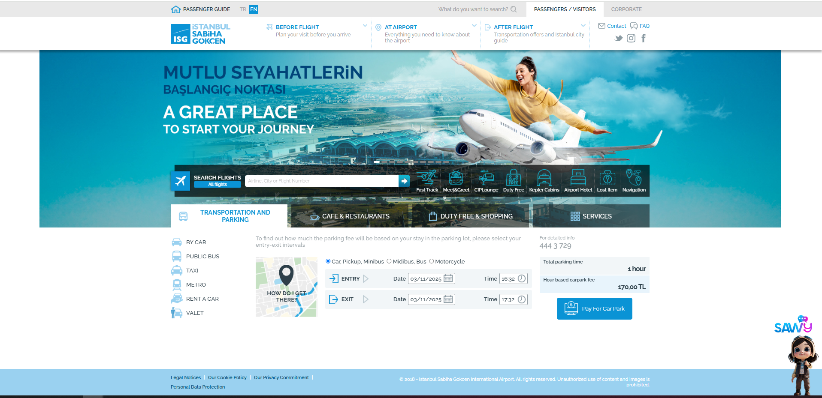
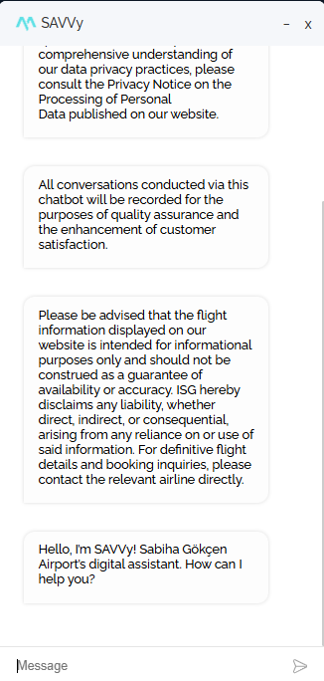
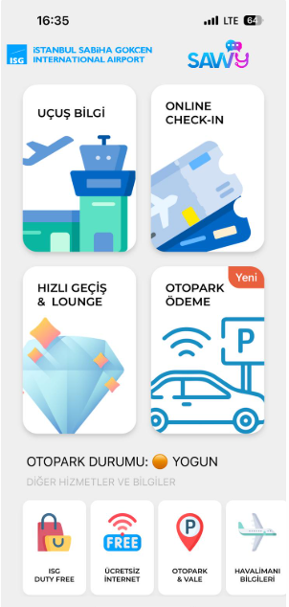
How to reach SAVVy?
https://www.sabihagokcen.aero/homepage

Slide 9
SAVVy Statics
 | SAVVy | Call Center | Call Center Cevaplanmış Çağrı Sayısı
Ocak'25 |  | 7,464 | 7,229
Şubat'25 |  | 10,923 | 10,725
Mart'25 |  | 7,291 | 7,038
Nisan'25 | 8,034 | 8,349 | 8,088
Mayıs'25 | 6,918 | 7,829 | 7,524
Haziran'25 | 6,953 | 8,543 | 8,287
Temmuz'25 | 8,423 | 9,870 | 9,521

Slide 10
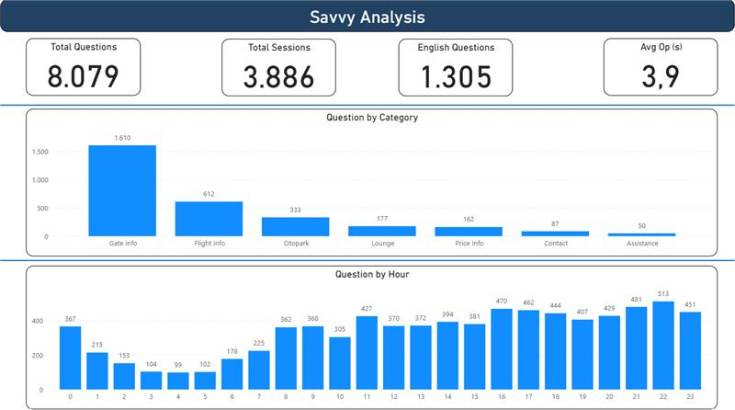
SAVVy August Statistics

Slide 11
The AI-supported aviation era has begun: Air travel is set to become safer, more efficient, and passenger-focused in the future.
2025
Thanks !

